Slide 1
"Exploring Melanoma Demographics, causes, and treatments"
Isha Saldhi
Somin Kim
Avary Edwards
Terry Cleek

Slide 2
Trends of Melanoma
Exploring Melanoma demographics in terms of incidences, age, and stages through data analytics
Reveal the frequency and distribution of cases
Understand age specific trends
Analyze stages of Melanoma to aid in assessing severity and treatment planning
Increase overall awareness and education on risk factors and prevention
By exploring demographics, we can develop more effective approaches for diagnosis and treatment.

Slide 3
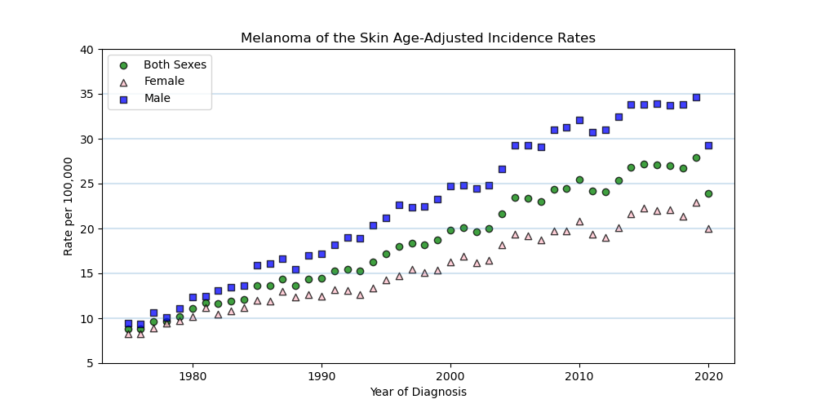
Increase In Melanoma Cases
Several possible reasons for increasing rate of Melanoma over the years. Increased sun exposure, environmental factors, changing demographics, increased awareness / detection, fashion trends, tanning beds, and genetic factors.

Slide 4
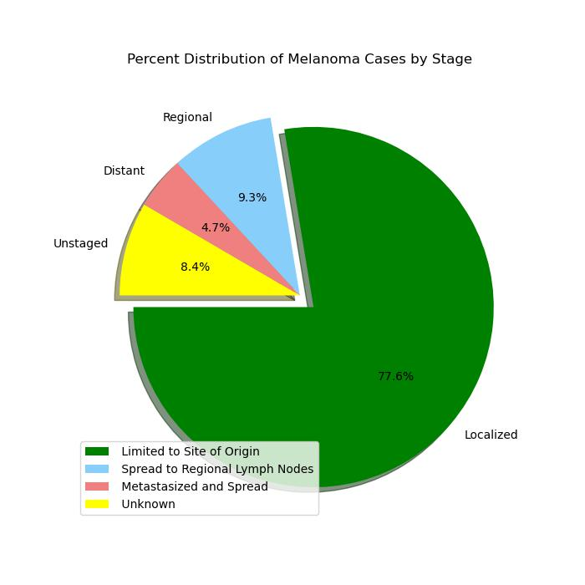
Melanoma Cancer Distribution by Stage
Each stage represents the extent of its spread and seriousness
Localized – limited to outermost layer of the skin
Regional – Has invaded the deeper layers of the skin or nearby lymph nodes
Distant – Spread to distant lymph nodes or organs (complex)
Unstaged – requires further evaluation

Slide 5
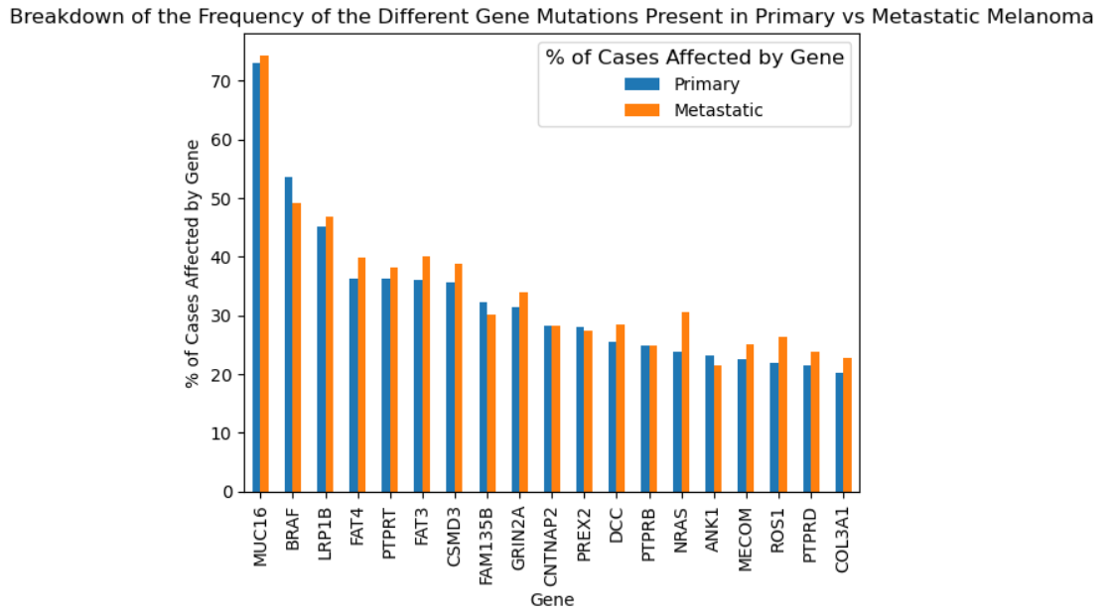
Prevalence of Gene Mutations in Primary and Metastatic Melanoma
This graph shows the frequency of mutations common to both metastatic and primary melanomas in all the cases of melanoma cancers that are in the NIH GDC Data Portal (382 cases for this dataset)
MUC16, BRAF, and LRP1B are the most common mutations that occur in both types of melanoma, and the largest difference is in the NRAS gene

Slide 6
Analysis and Next Steps
Analysis:
Next Steps:
From this data, the top three mutations are MUC16, BRAF, and LRP1B.
The most common mutations are likely either easier to mutate, or better at causing cells to become cancerous, for them to be so highly prevalent.
For genes that are higher for metastatic melanomas and not as much for primary melanomas, its possible that these genes help the cancer cell migrate to new areas, or they help the cell become cancerous in a different area of the body
Next steps would be to look at these genes amongst all cancers, and see how the rates in other cancers differ to melanoma.
Another thing would be to see if there is data on where the metastatic melanomas migrated from.
By looking into the specific genes themselves, one could see if there are any specific pathways or mechanisms that are more likely to be mutated in melanoma, or if it is the same amongst all cancers.

Slide 7
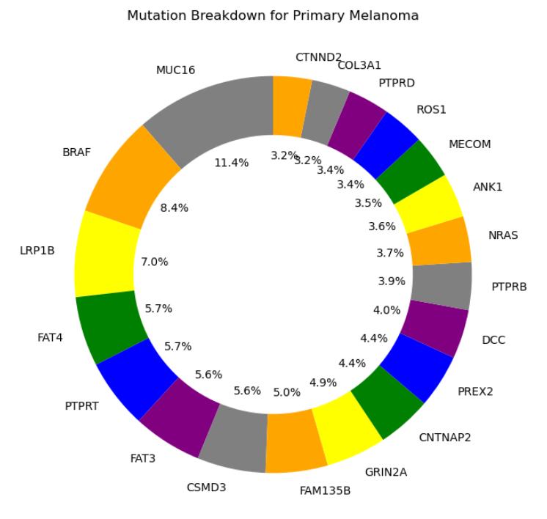
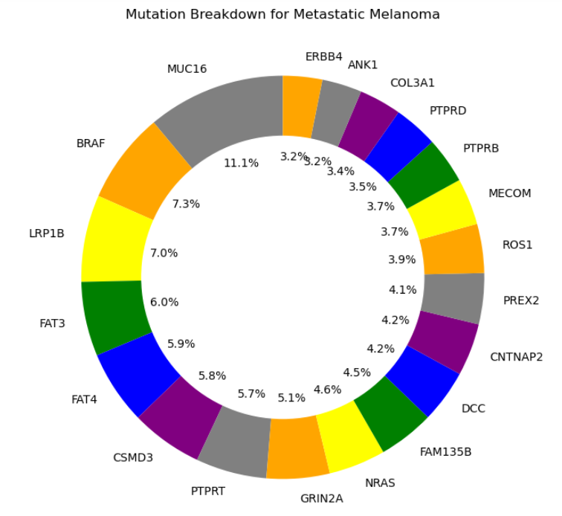
These pie charts show the relative proportions of that gene mutation for primary or metastatic melanoma. While many of these genes are present in both types, CTNND2 is only present in primary melanoma and ERBB4 is only present in metastatic melanoma

Slide 8
Analysis and Next Steps
These pie charts shows the composition of the different genes relative to their frequency across the database for melanoma, so a higher value here means that there is a higher proportion of that mutation present relative to the other ones
While the differences here are smaller than the bar chart, it is because it is looking at the distribution between the different genes rather than that gene’s particular statistics
Next steps would be to get a larger data set, and possibly compare to other types of cancers, and to look at the different specific kinds of mutation for a gene, and what is most prevalent

Slide 9
Hurdles Faced and Things to Look at Next
Some hurdles that were faced when gathering this data was the vastness of the GDC database. To fully download all the relevant cases, it would have been about 15 terabytes of storage, and so that was not possible. Also, some cases require certain clearance levels to access. This data is pretty top level, there is more detailed data within the database, but it requires a higher learning curve to be able to utilize than was possible to figure out in the allotted time.
Some things that would be interesting to look at next to take the research further would be to extend this analysis to other types of cancers, and then compare the different types of cancers to each other, as well as looking at the gene prevalence throughout all cancers.
To take this research to the next level, some things to look into would be the base pair substitutions/deletions and the prevalence of those, especially if looking at it through different categories of genes, and through different cancer types. Some data that was not included in the dataset, But would have been interesting to look at would be: what treatment was given, detailed demographics of the patient, how advanced/aggressive the cancer was, how long it took to treat, and family history or lifestyle risks for that particular cancer.

Slide 10
Exploring the financial burden of melanoma
Melanoma is a prevalent cancer in today’s society, but as SES disparities are one of the most pressing issues in the US, does the financial burden of cancer, specifically melanoma, differ amongst race populations?
We will look at NCI and US Census information to determine the following:
How expensive is melanoma treatment in comparison to other cancers?
Are races disproportionately likely to be diagnosed with melanoma?
Are mortality rates amongst populations the same?
If they are, what is a possible cause for it?

Slide 11
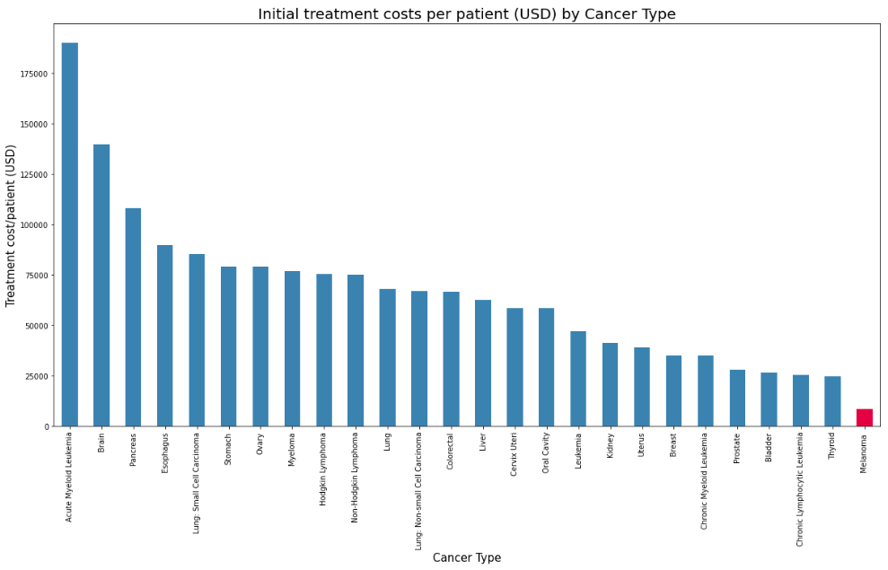
Cancer costs by cancer type
Out of the 25 most common cancers, melanoma is by far has the cheapest treatment cost per patient: $8536.7

Slide 12
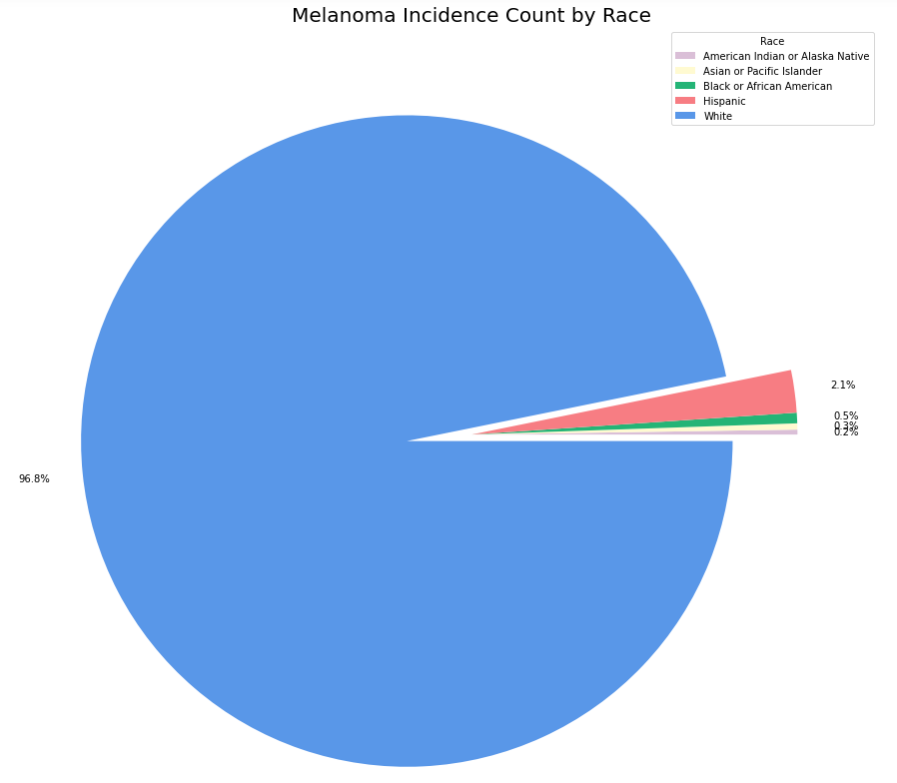
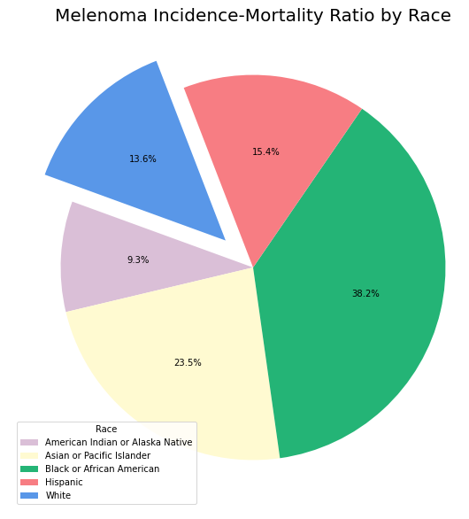
Melanoma Incidence and Mortality Rates
Even though whites were the most heavily effected population in terms of incidence melanoma, whites do not have the highest incidence mortality rate. Blacks, asians and hispanics hold the highest inicidence-mortality rates amongst the analyzed populations.

Slide 13
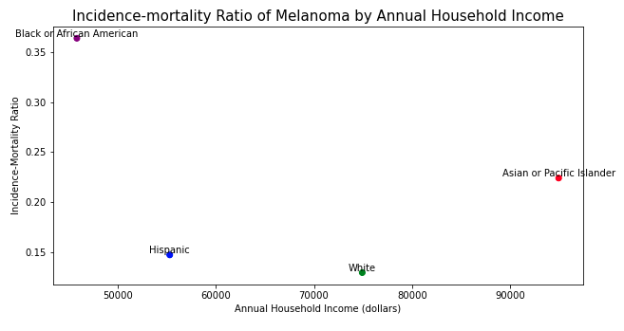
Why the disparity in incidence-mortality rates amongst different races?
Hypothesis: There is an inverse correlation between incidence-mortality and annual household income.
While it could be true that Blacks and African Americans have the highest incidence-mortality rate of all races due to their low household-income, it cannot be said that just by having a high annual income one will have a low incidence-mortality ratio, as exhibited by the Asian population.

Slide 14
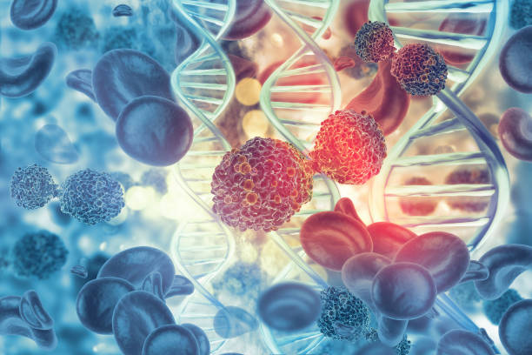
Conclusion
In conclusion, while melanoma treatment costs are relatively low in comparison to other cancers, race groups are disproportionately affected by melanoma, with Whites having the highest incidence counts. However, they have one of the lowest incidence-mortality ratios, suggesting that there is a confounding variable that helps or harms survival chances of various race populations. While social economic status can be a potential factor, it is not a sole or primary driver in mortality/survival rates amongst melanoma patients.

Slide 15
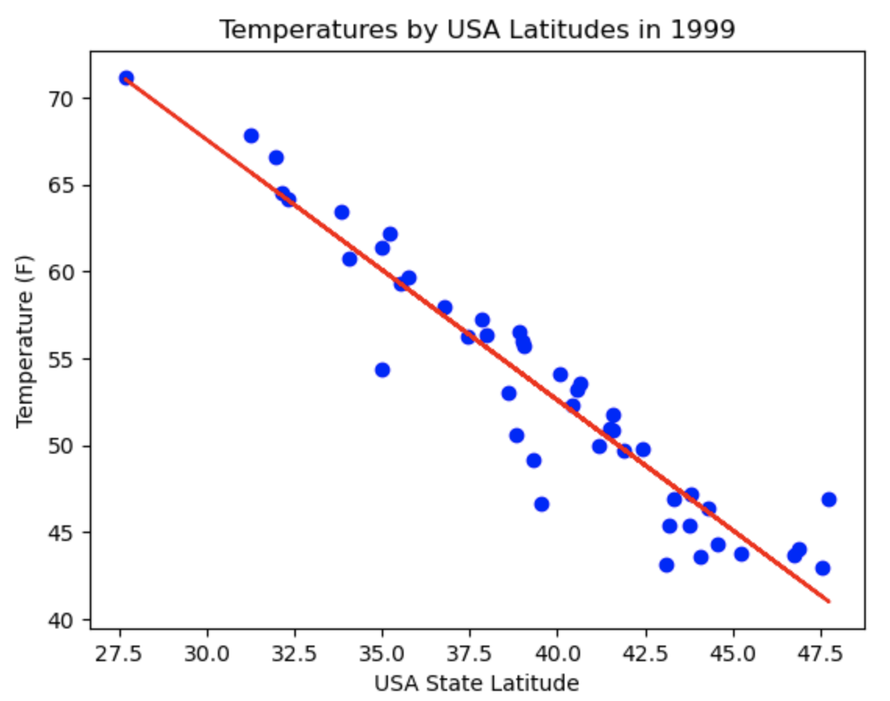
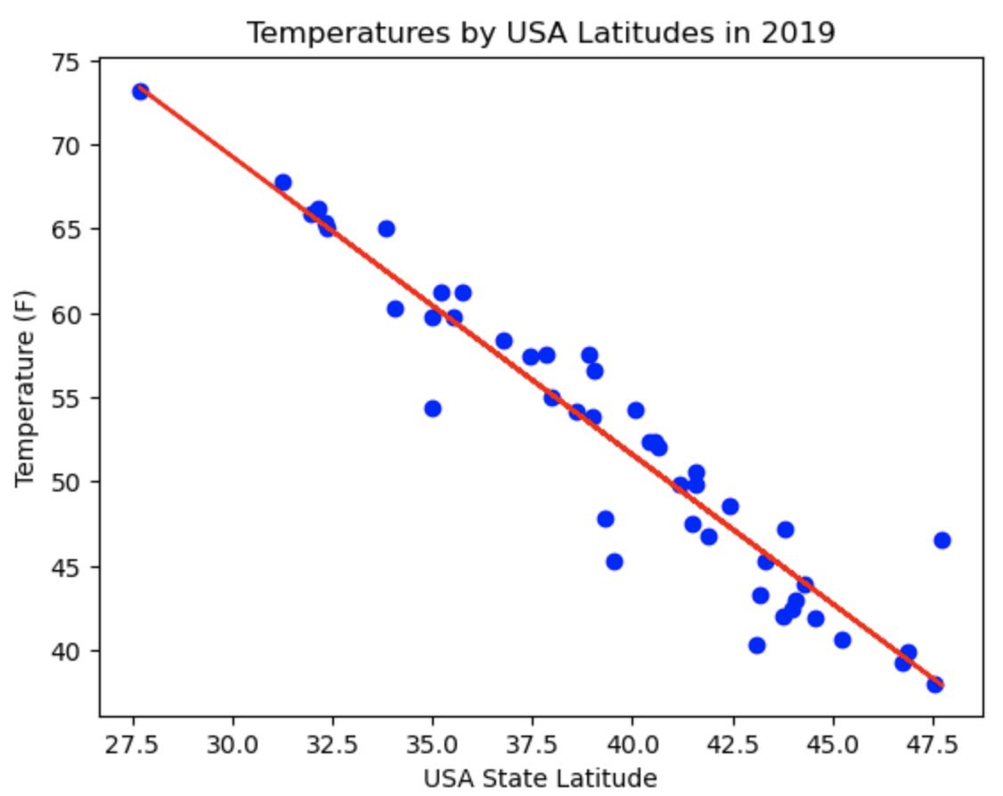
Testing to correlation between Melanoma Incidence and USA Latitude
Proving the relationship between Temperature and Latitude:
Lower Latitude (closer to the equator) correlates to a higher temperature.
The correlation between temperature and latitude is consistent between 1999 and 2019

Slide 16
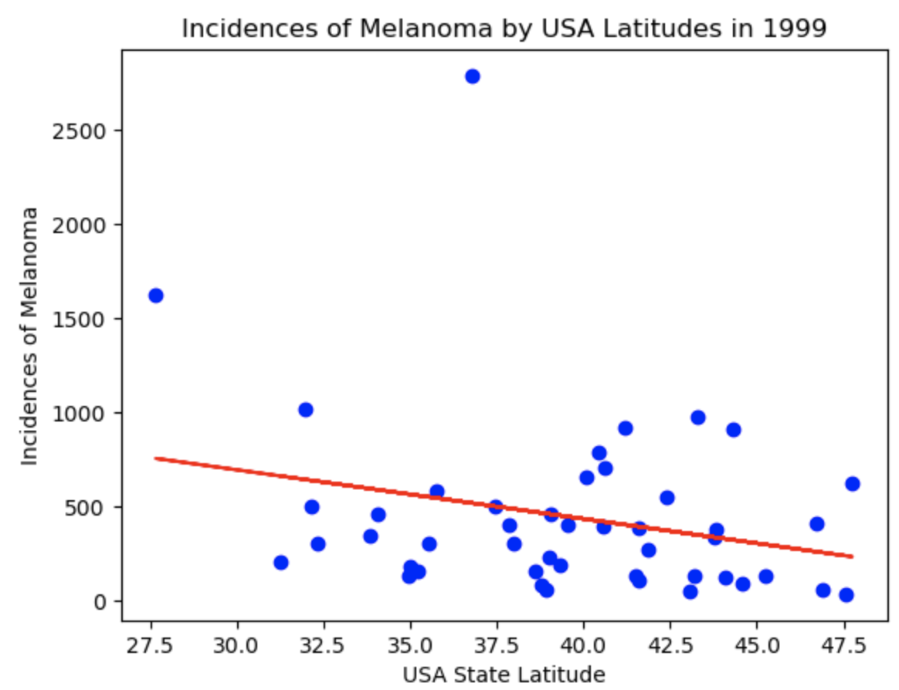
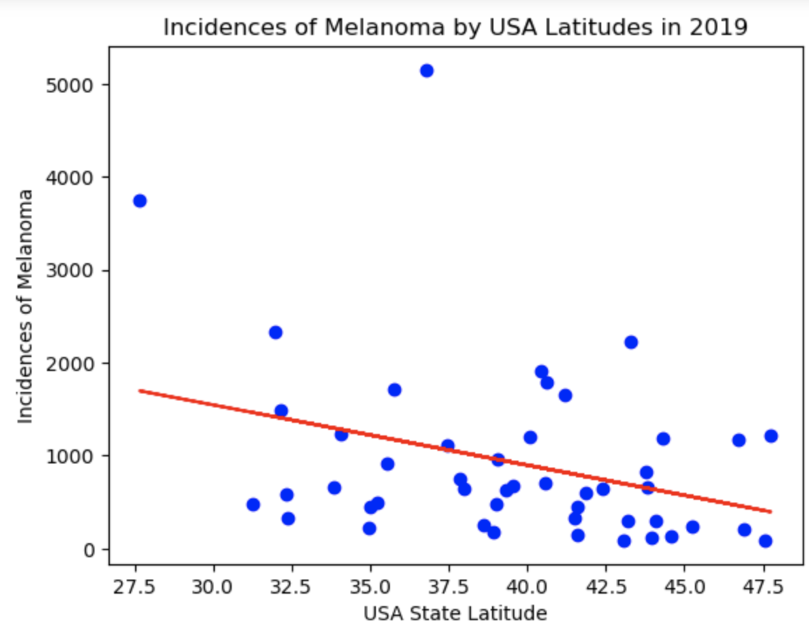
Testing to correlation between Melanoma Incidence and USA Latitude
Proving the relationship between Incidence of Melanoma and Latitude:
Lower Latitude (closer to the equator) correlates to a higher temperature.
The correlation between temperature and latitude is consistent between 1999 and 2019
y = -25.99x + 1472.06
Correlation Coefficient is -0.25579963641022196
R-squared is 0.06543345398760175
y = -64.84x + 3491.09
Correlation Coefficient is -0.3256846971959199
R-squared is 0.10607052198759805
In both 1999 and 2019, there is a low correlation coefficient between Melanoma incidence and Latitude: the R² is very low for both. Indicating that it is unlikely that someone’s latitude would contribute to their chance of getting Melanoma.
Independent T-test: p-value = 0.00277553

Slide 17
Results of Melanoma Incidence vs. Latitude
Null hypothesis: The means for the two populations are equal.
Alternative hypothesis: The means for the two populations are not equal.
Since the P-value for the incidences of melanoma is <= 0.05, we can reject that 1999 and 2019 have the same number of incidences of Melanoma. This means that the populations of 1999 and 2019 have differences in their incidences of Melanoma. So we can conclude that between these years there are factors that would have contributed to this change, but we are unable to prove that someone’s latitude is one of these contributing factors.

